Slide 1
The Mistery of Autoencoders Unravelled
Dr. ShaiLESH SIVAN
Cochin University of Science and Technology

Slide 2
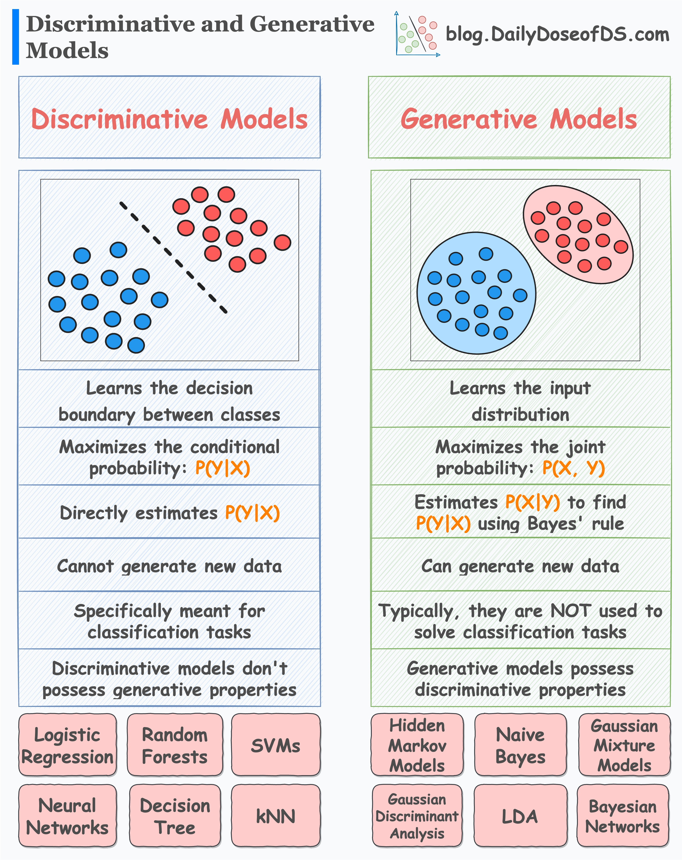
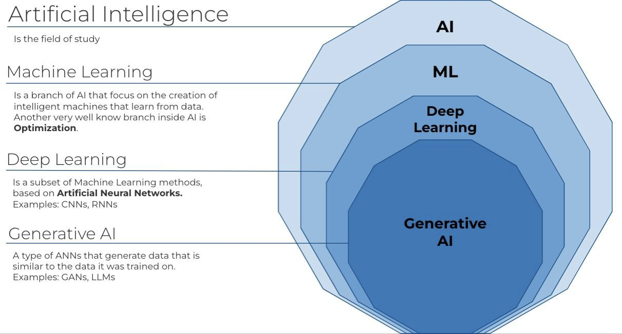
Generative AI/MODELS

Slide 3
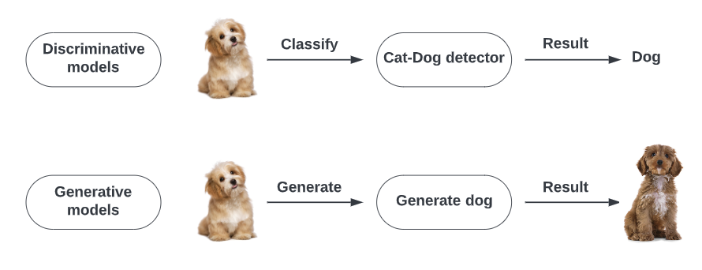
GeneRATIVE vs DISCRIMINATIVE MODELS

Slide 4
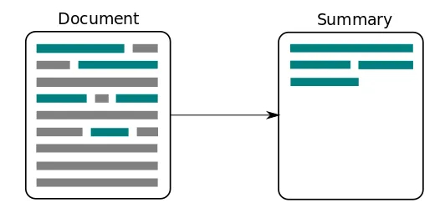
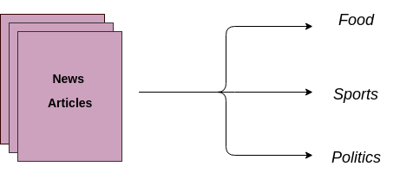
GeneRATIVE vs DISCRIMINATIVE MODELS
Discriminative Model
Generative Model

Slide 5
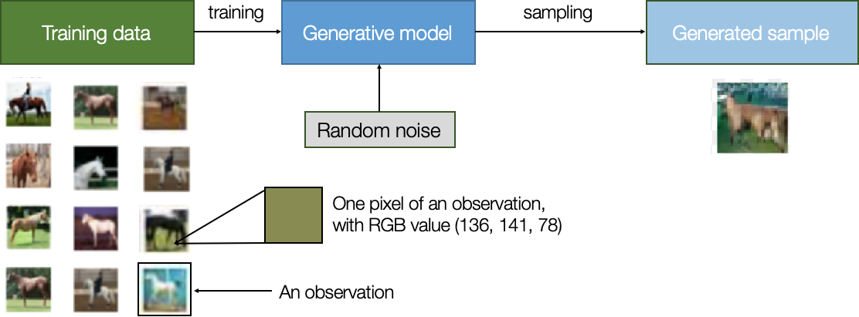
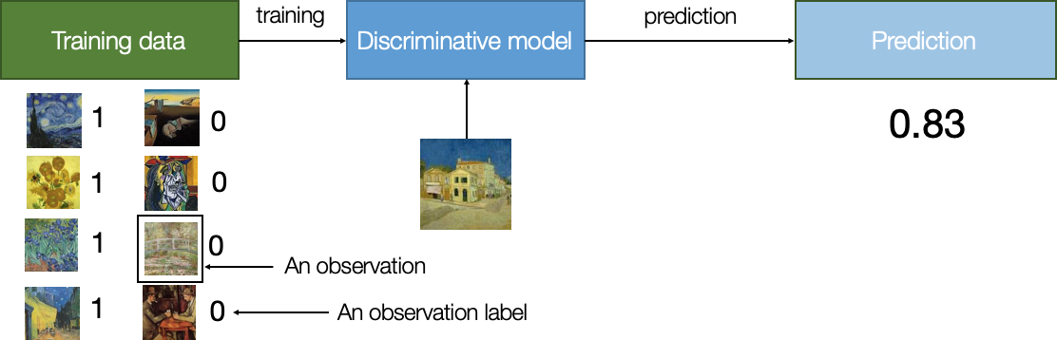
GeneRATIVE vs DISCRIMINATIVE MODELS

Slide 6
HOW GENERATIVE MODELS WORKS?

Slide 7
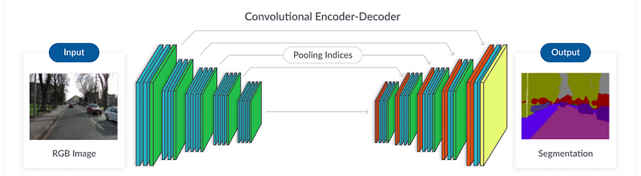
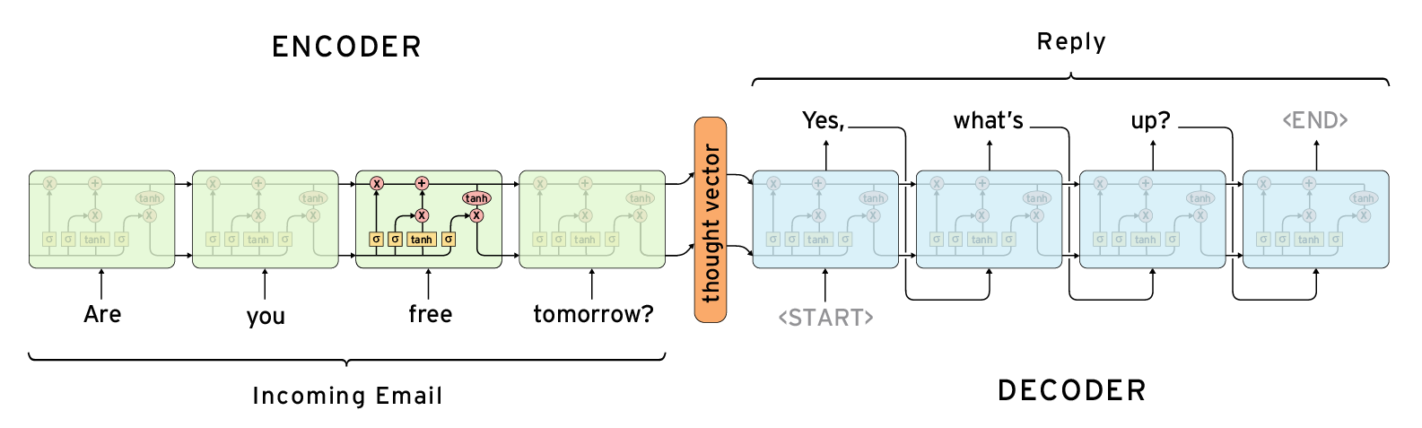
ENCODER-DECODER

Slide 8
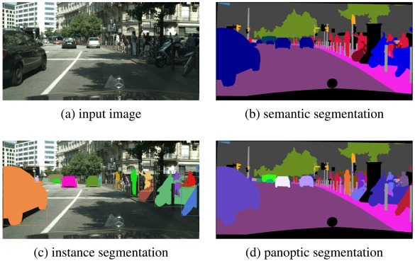
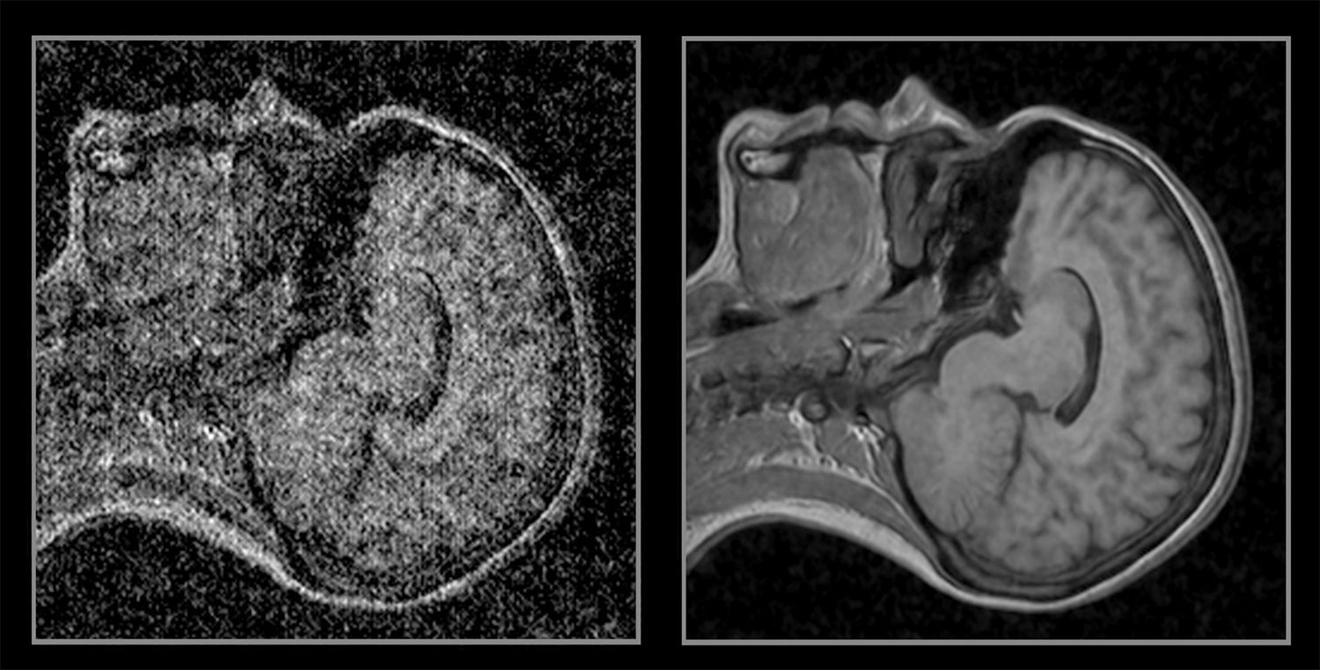
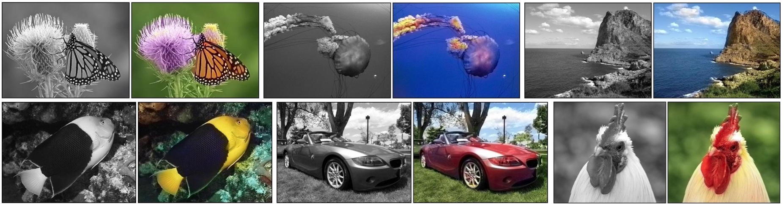
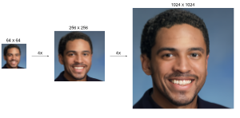
ENCODER-DECODER(VISION)

Slide 9
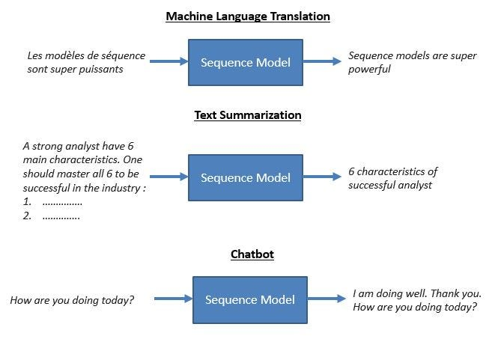
ENCODER-DECODER(TEXT)

Slide 10
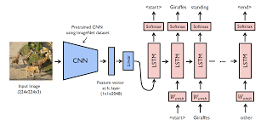
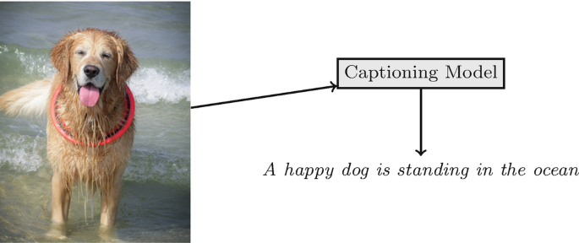
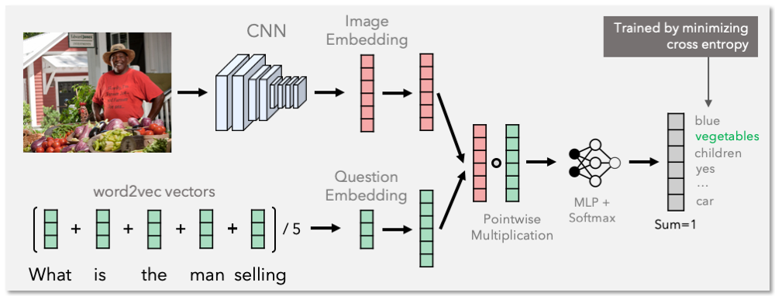
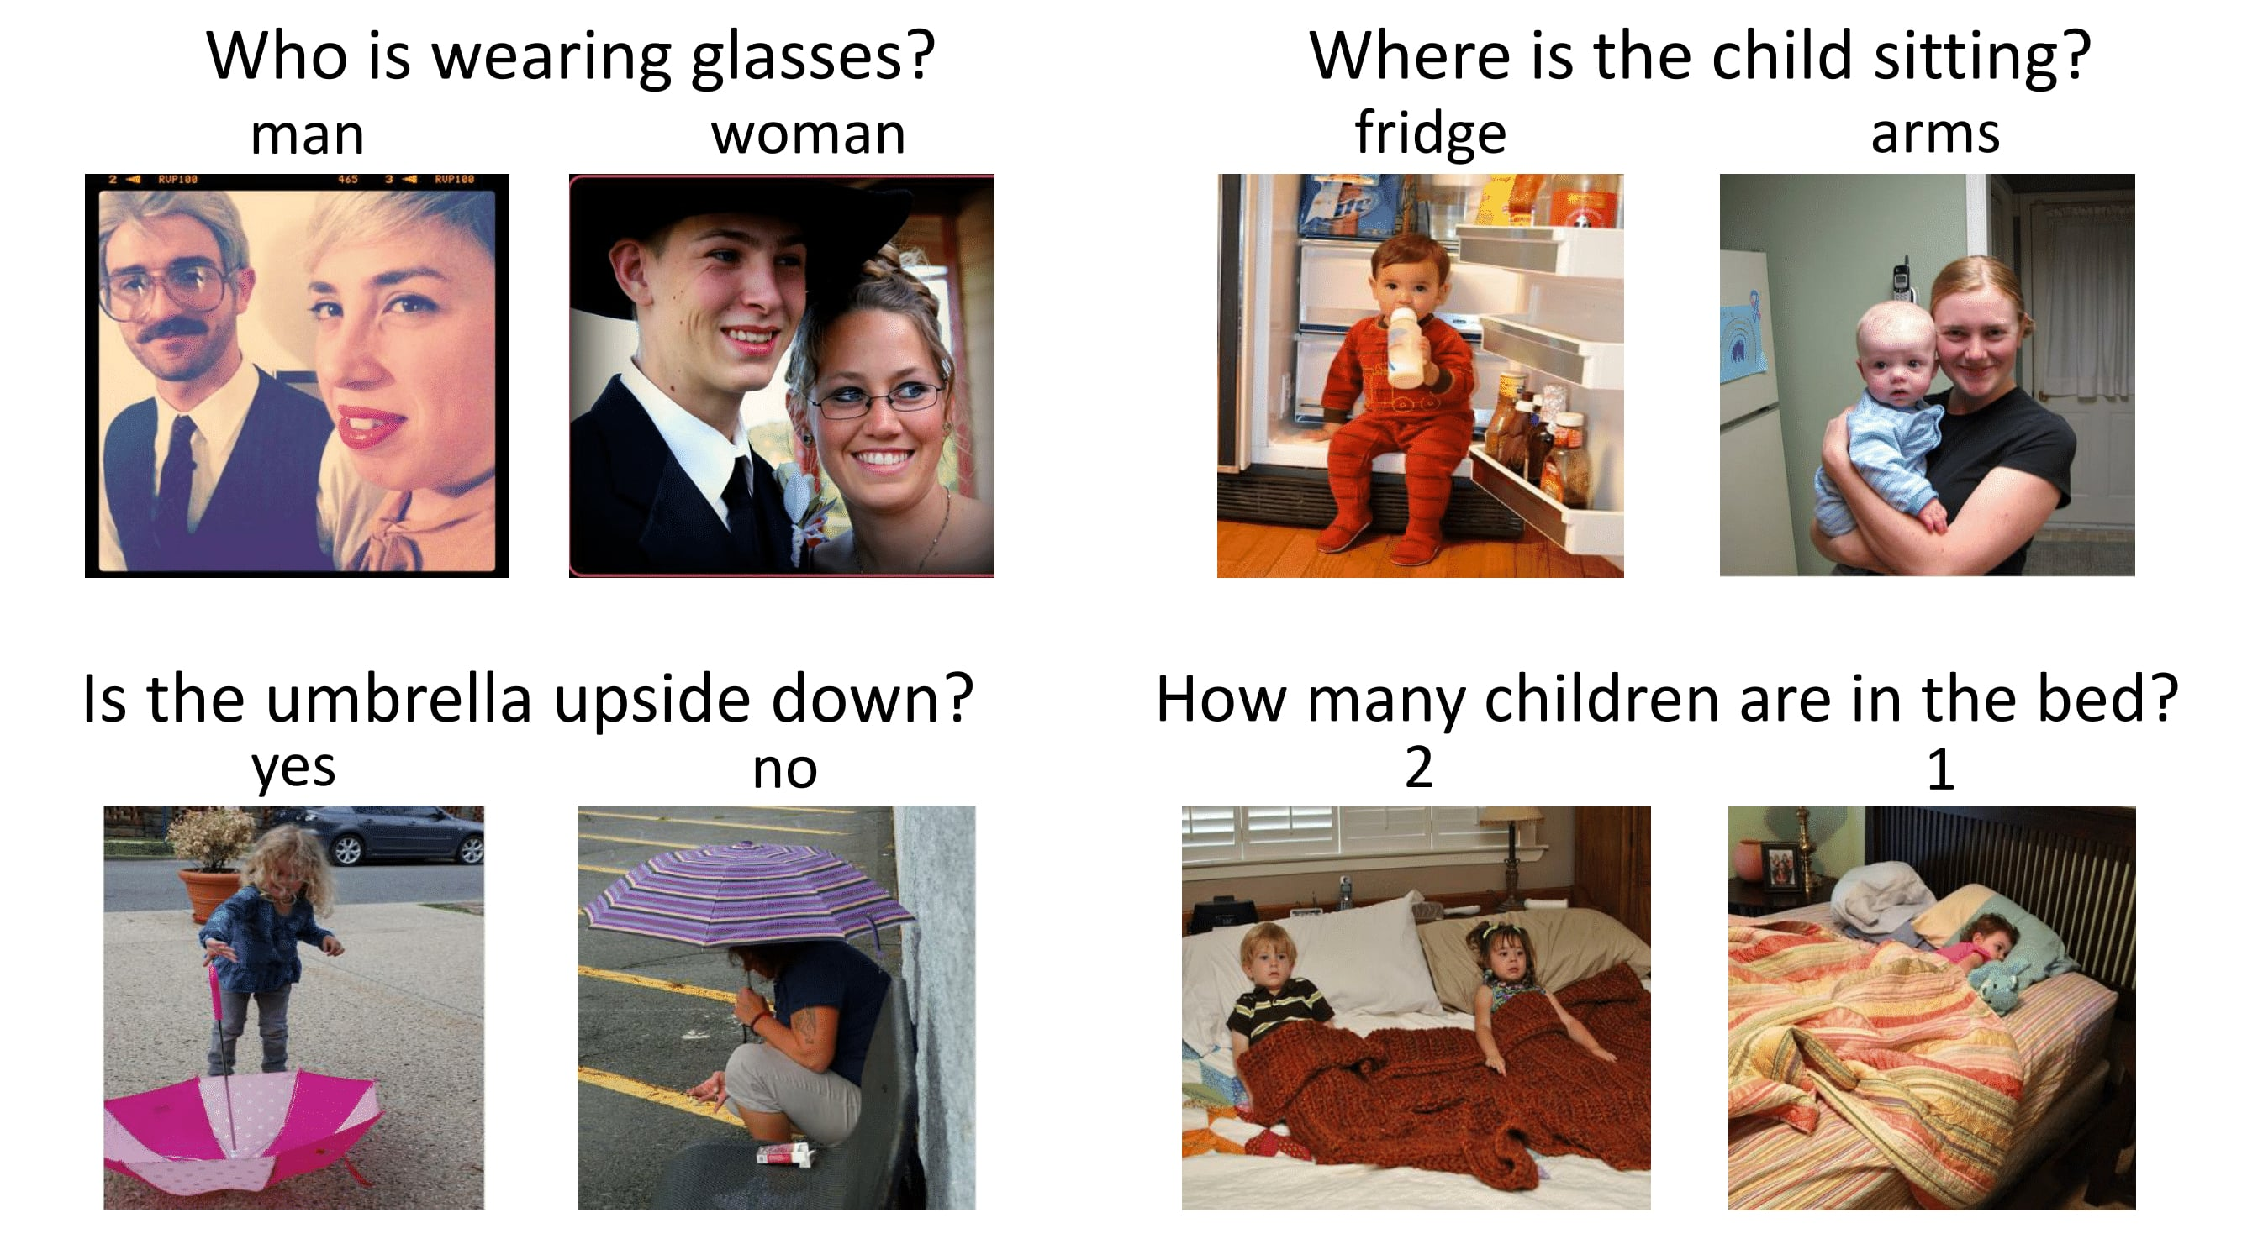
ENCODER-DECODER(TEXT-VISION)
IMAGE CAPTIONING
VISUAL QUESTION ANSWERING

Slide 11
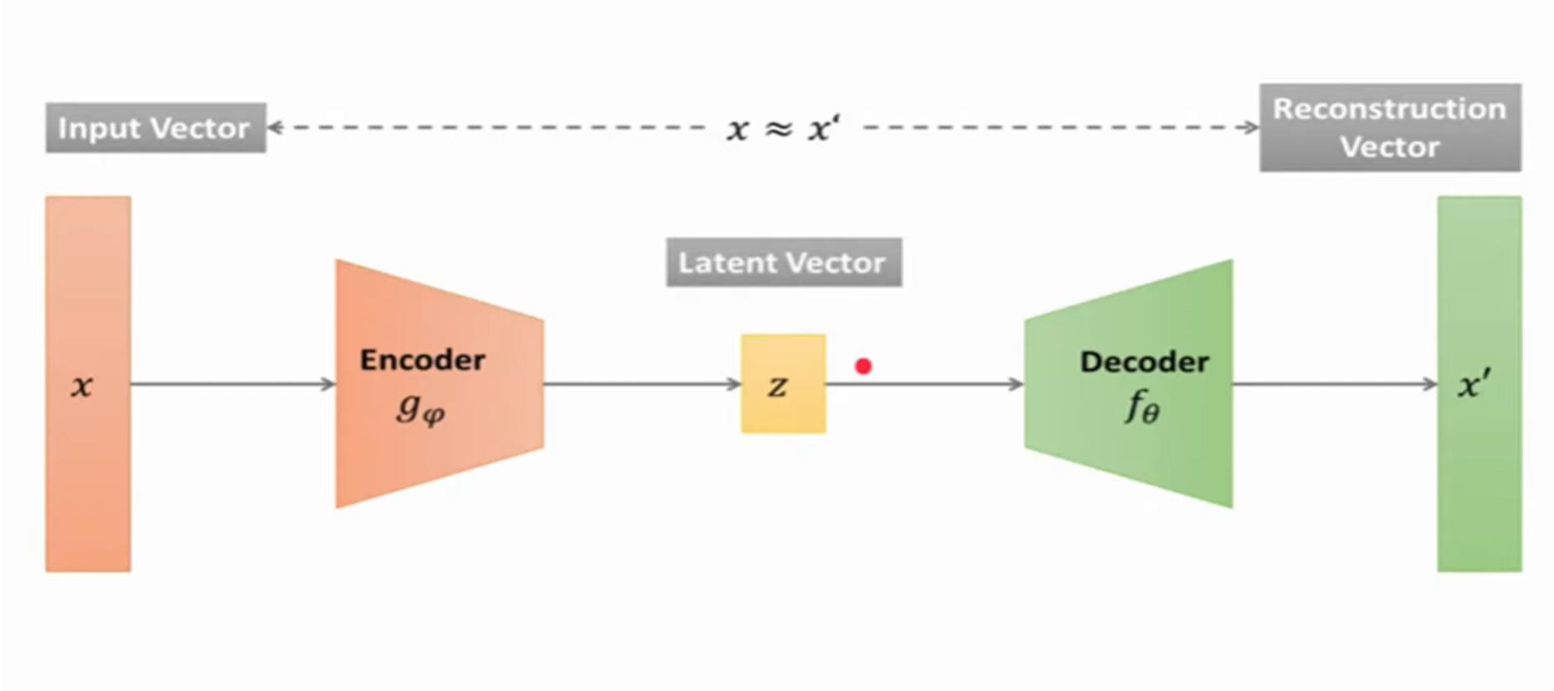
Autoencoders
Bottleneck/Code
knowledge-representation of the input.
Eg: maximum information possessed by an image is captured

Slide 12
Autoencoders
Autoencoders consist of 3 parts:
1. Encoder: A module that compresses the train-validate-test set input data into an encoded representation that is typically smaller than the input data.
2. Bottleneck: A module that contains the compressed knowledge representations and is most important part of the network.
3. Decoder: A module that helps the network “decompress” the knowledge representations and reconstructs the data back from its encoded form. The output is then compared with a ground truth.
Distribution learning
its unsupervised

Slide 13
Applications of autoencoders

Slide 14
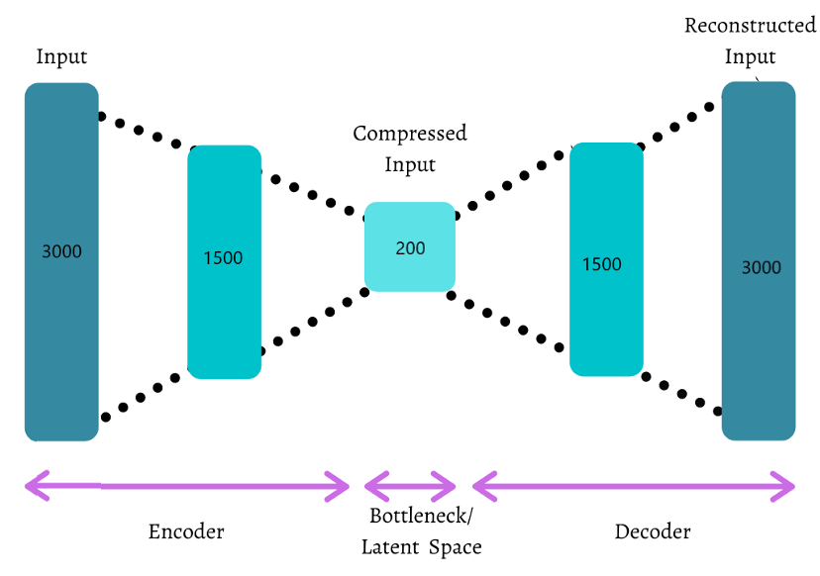
1. Dimensionality Reduction
Autoencoders train the network to explain the natural structure in the data into efficient lower-dimensional representation. It does this by using decoding and encoding strategy to minimize the reconstruction error
The input and the output dimension have 3000 dimensions, and the desired reduced dimension is 200.

Slide 15
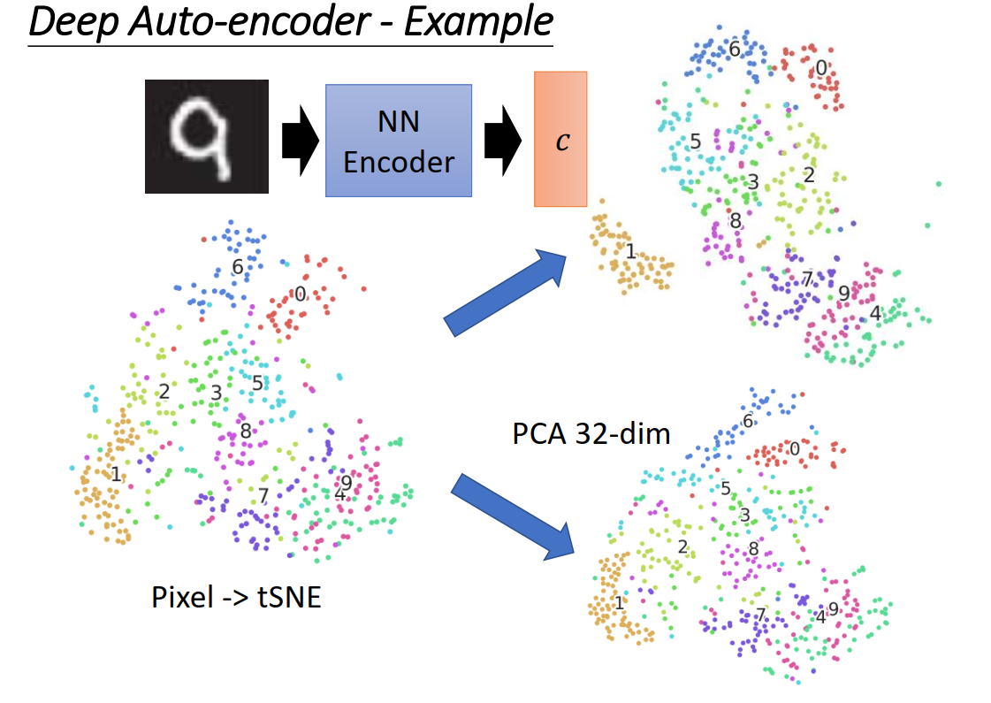
Pca vs autoencoders
For dimensionality reduction
PCA can only build linear relationships.
undercomplete autoencoders that can learn non-linear relationships
perform better in dimensionality reduction.
Loss function = |x-x^|

Slide 16
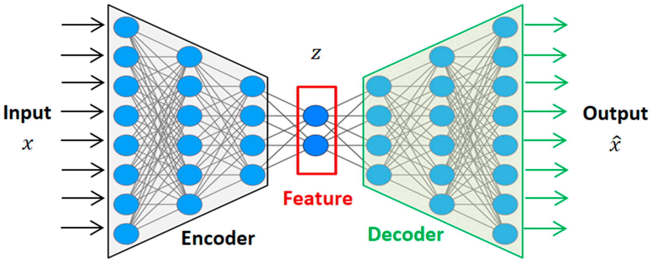
2. Feature extraction
Autoencoders can be used as a feature extractor for classification or regression tasks. Autoencoders take unlabeled data and learn efficient codings about the structure of the data that can be used for supervised learning tasks.
After training an autoencoder network using a sample of training data, we can ignore the decoder part of the autoencoder, and only use the encoder to convert raw input data of higher dimension to a lower dimension encoded space. This lower dimension of data can be used as a feature for supervised tasks.

Slide 17
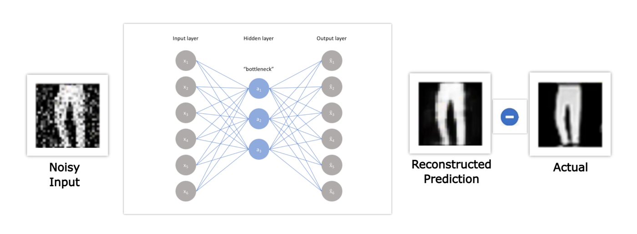
3. Denoising autoencoders
The real-world raw input data is often noisy in nature, and to train a robust supervised model requires cleaned and noiseless data. Autoencoders can be used to denoise the data.
Image denoising is one of the popular applications where the autoencoders try to reconstruct the noiseless image from a noisy input image.

Slide 18
3. Denoising autoencoders
A denoising autoencoder learns from a corrupted (noisy) input; it feed its encoder network the noisy input, and then the reconstructed image from the decoder is compared with the original input.
The idea is that this will help the network learn how to denoise an input. It will no longer just make pixel-wise comparisons, but in order to denoise it will learn the information of neighboring pixels as well.
The corruption process typically follows one of two approaches.
Approach 1: We can randomly set some of the inputs (as many as half of them) to zero or one; most commonly it is setting random values to zero to imply missing values.This can be done by manually inputting zeros or ones into the inputs or adding a dropout layer between the inputs and first hidden layer.(salt and pepper noise)
Approach 2: adding pure Gaussian noise
Training a denoising autoencoder is nearly the same process as training a regular autoencoder. The only difference is we supply our corrupted inputs to training_frame and supply the non-corrupted inputs to validation_frame.

Slide 19
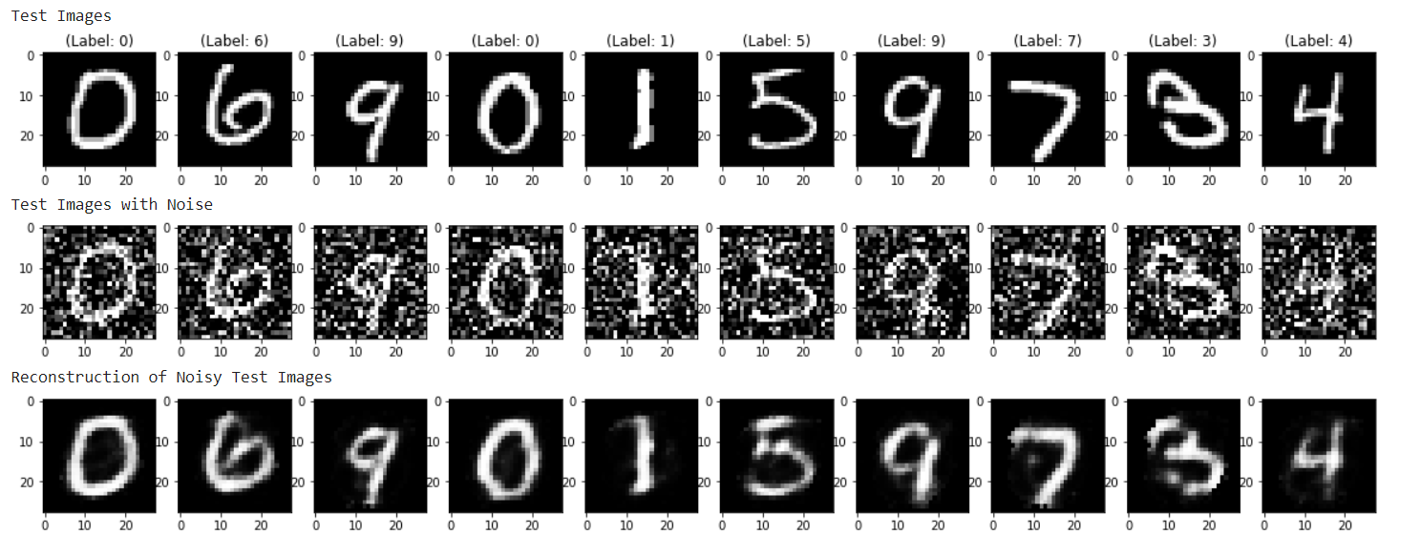
3. Denoising autoencoders

Slide 20
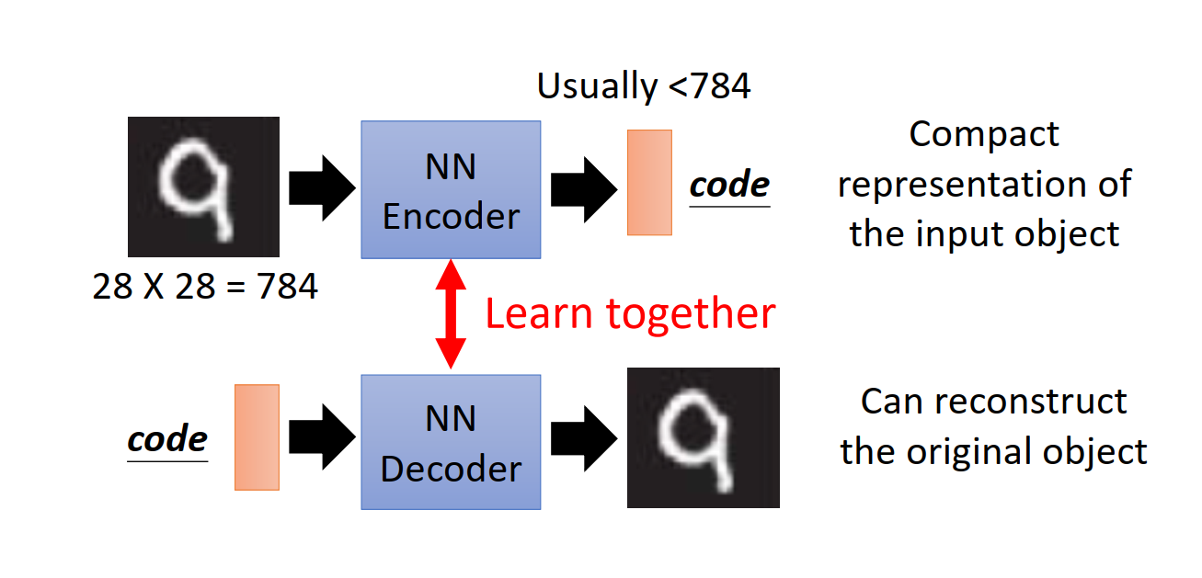
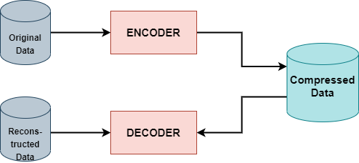
4. image Compression:
Image compression is another application of an autoencoder network. The raw input image can be passed to the encoder network and obtained a compressed dimension of encoded data. The autoencoder network weights can be learned by reconstructing the image from the compressed encoding using a decoder network.

Slide 21
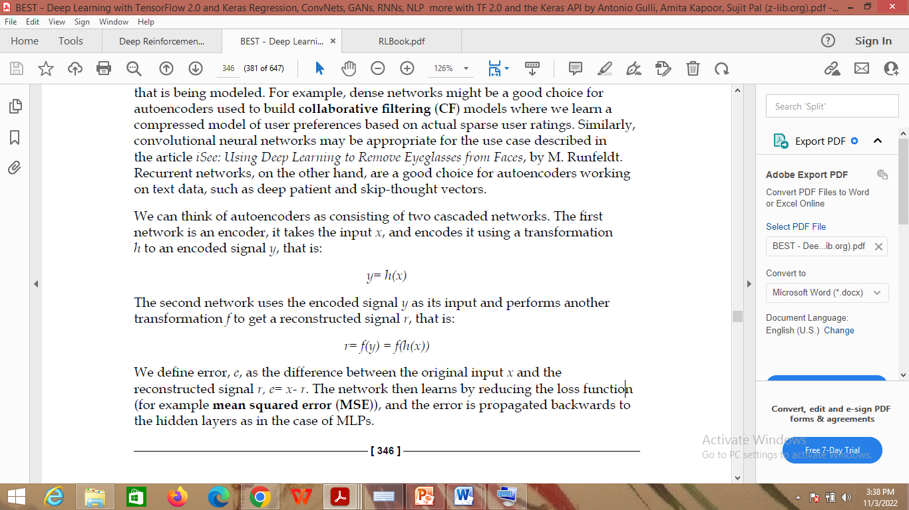

4. image Compression:
We can think of autoencoders as consisting of two cascaded networks.
The first network is an encoder, it takes the input x, and encodes it using a transformation h to an encoded signal y, that is:
The second network uses the encoded signal y as its input and performs another transformation f to get a reconstructed signal r, that is:
We define error, e, as the difference between the original input x and the reconstructed signal r, e= x- r.
The network then learns by reducing the loss function (for example mean squared error (MSE)), and the error is propagated backwards to the hidden layers as in the case of MLPs.

Slide 22
types of autoencoders
Depending upon the actual dimensions of the encoded layer with respect to the input, the loss function, and constraints, there are various types of autoencoders:
Undercomple Autoencoders
Overcomplete Autoencoders
Denoising autoencoders
Stacked autoencoders
Sparse autoencoders
Variational Autoencoders

Slide 23
1. Under complete autoencoders
Under complete autoencoders is an unsupervised neural network that you can use to generate a compressed version of the input data.
It is done by taking in an image and trying to predict the same image as output, thus reconstructing the image from its compressed bottleneck region
Compression
Dimensionality reduction.

Slide 24
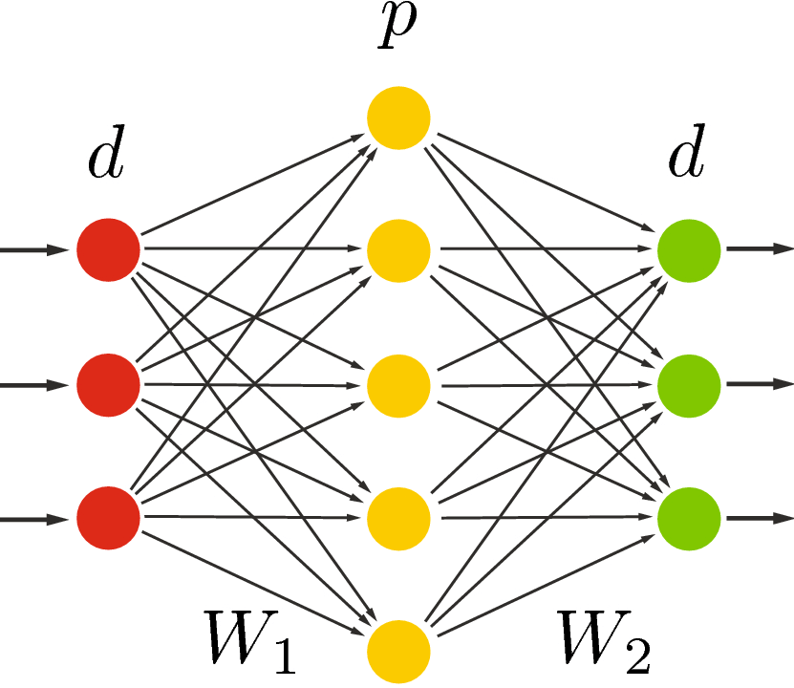
2. over complete autoencoders
more hidden units than the number of input units.
The idea behind using more hidden units is to learn a more complex, non-linear function that can better capture the structure of the data.
Advantages
ability to learn more complex representations of the data, which can be useful for tasks such as feature extraction and denoising.
more robust to noise and can handle missing data better than traditional autoencoders
Disadvantages
One of the main disadvantages is that they can be more difficult to train than traditional autoencoders.
the extra hidden units can cause overfitting, which can lead to poor performance on new data.

Slide 25
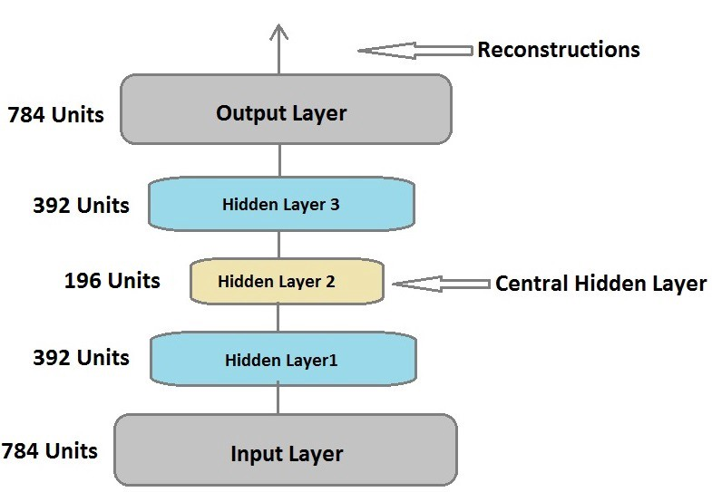
3. stacked autoencoders
Until now we have restricted ourselves to autoencoders with only one hidden layer.
We can build Deep autoencoders by stacking many layers of both encoder and decoder; such an autoencoder is called a Stacked autoencoder.
The stacked autoencoder can be trained as a whole network with an aim to minimize the reconstruction error

Slide 26
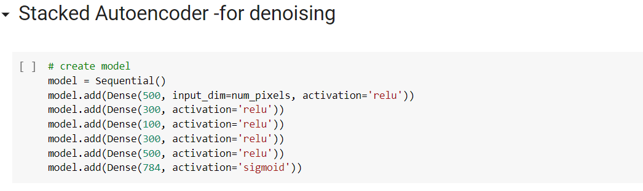
3. stacked autoencoders

Slide 27
4. sparse autoencoders
The idea behind Sparse Autoencoders is that we can achieve an information bottleneck (same information with fewer neurons) without reducing the number of neurons in the hidden layers.
Since it is difficult to design a neural network with a flexible number of nodes at its hidden layers, sparse autoencoders work by penalizing the activation of some neurons in hidden layers.
According to the sparsity constraint, only some percentage of nodes can be active in a hidden layer. The neurons with output close to 1 are active, whereas the neurons close to 0 are in-active neurons.
More specifically, we penalize the loss function such that only a few neurons are active in a layer. We force the autoencoder to represent the input information in fewer neurons by reducing the number of neurons.
As a means of regularizing the neural network, the sparsity function prevents more neurons from being activated.

Slide 28
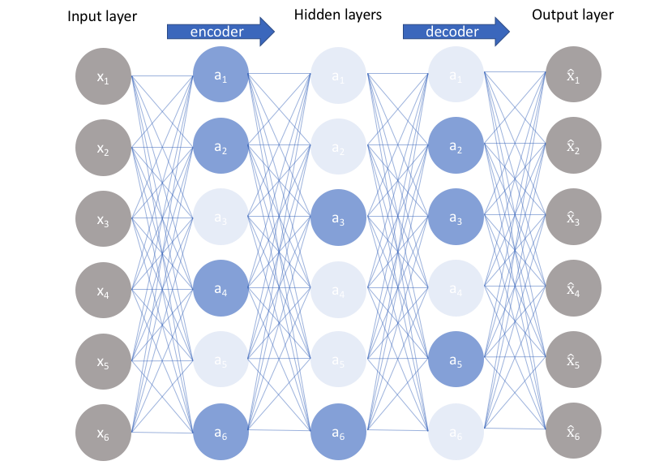
4. sparse autoencoders

Slide 29
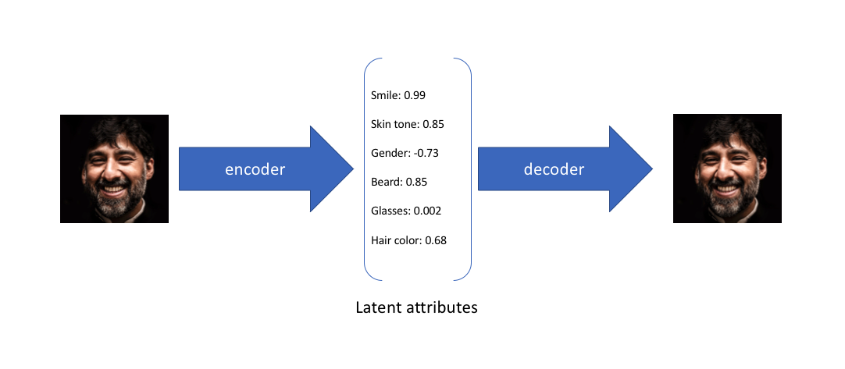
5. Variational Autoencoder
Intuition
To provide an example, let's suppose we've trained an autoencoder model on a large dataset of faces with a encoding dimension of 6. An ideal autoencoder will learn descriptive attributes of faces such as skin color, whether or not the person is wearing glasses, etc. in an attempt to describe an observation in some compressed representation.

Slide 30
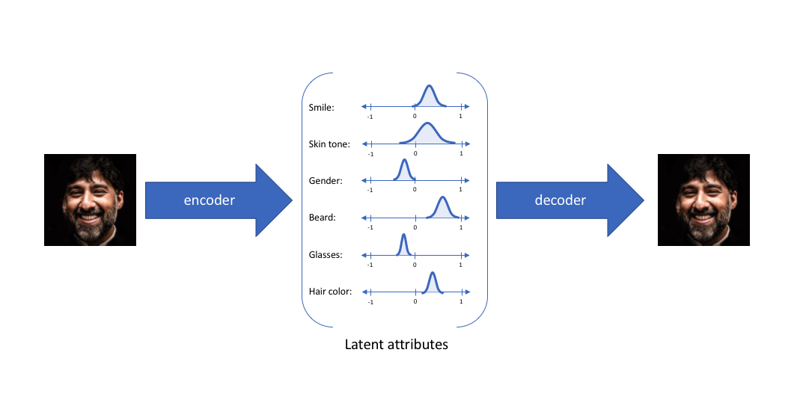
5. Variational Autoencoder
we've described the input image in terms of its latent attributes using a single value to describe each attribute. However, we may prefer to represent each latent attribute as a range of possible values. Using a variational autoencoder, we can describe latent attributes in probabilistic terms.

Slide 31

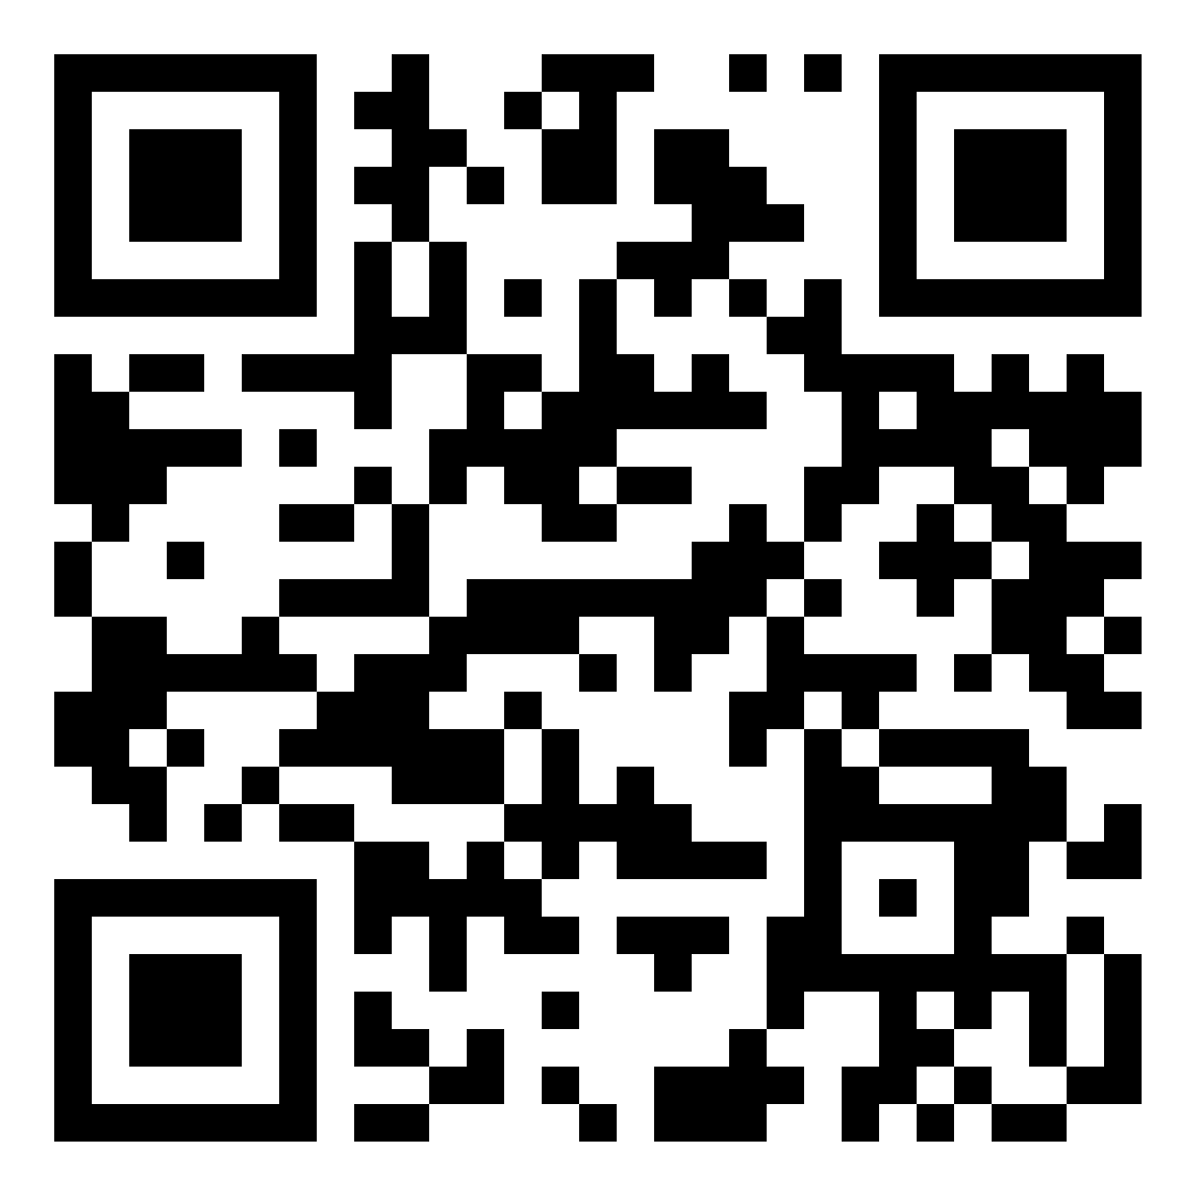



Dr. Shailesh Sivan
+91 8907230664
shaileshsivan@cusat.ac.in
https://shaileshsivan.info

Slide 32


